Slide 1
Ms. Colliver
6th Grade
Physical Education
Email:
CCOLLIVER@
WCCUSD.NET

Slide 2
Teacher Contact:
Email:
CCOLLIVER@WCCUSD.NET
Best way to contact
Response will be during school hours
Please allow 2 full school days for a response

Slide 3
Need More Information?
Go to the Hercules Middle School Website
www.wccusd.net/
domain/1264
Click on the “Academics” tab
Click on the “Teachers” tab
Click on the teacher’s name

Slide 4
Dressing for Physical Education:
SCHOOL PE UNIFORM or
PLAIN LIGHT BLUE, GREY, or BLACK t-shirt
PLAIN BLACK shorts (no pockets)
Athletic Shoes
Clothing worn only for PE

Slide 5
Shoes
Shoes that should NOT be worn for PE and will result in a loss of all points for the day:
Crocs
Slides, Flip-flops, Sandals
Boots or Uggs
“Dress” Shoes
Slippers
Platforms
Yeezy Foam Shoes
Athletic Shoes
Fit
Offer support
Stay on the student’s feet
Students may change shoes at the beginning & end of the period.

Slide 6
Why do we dress for PE?
Good hygiene practice.
Job Practice – nearly all jobs have some dress code or uniform (gas attendant, target employee, doctor, lawyer).
Visibility! – With so many students it makes it easier to SEE who should be in the PE area and who is not supposed to be there (safety).
We don’t want to ruin your nice school clothes or shoes – accidents happen a lot, especially in 6th grade.

Slide 7
How do I know if my child dressed for PE?
Stamp in the student’s planner
PowerSchool - “Z” in the ATTENDANCE screen

Slide 8
Necessities
Water Bottle
Asthma Inhalers**
If your child has asthma, a specific form is required to have their inhaler or any medication on their person or in their backpacks, please pick up this form from the main office or district nurse webpage.
Student Planner
If the student forgot their PE uniform or upon request.
Refill Stations:
Cafeteria - 2
Gym - 2
Girls’ Locker Room
Boys’ Locker Room

Slide 9
Typical Class Day
Warm-up
Cardiovascular Endurance Activity:
Run to a song (3-5 minutes)
Agility Laps (running, skipping, side-shuffle, high knees, butt kickers, straight-leg run, back peddle, karaoke or grapevine)
Flexibility:
Static or Dynamic Stretching Routine
Specific routine
Students lead by roll call row, rotate every week
Name the muscles before stretching them
Count using multiplication tables
Main Activity
Fitness monitoring (one per week),
Drills (learning skills),
Cooperative game,
Sport game

Slide 10
Excused Absence
Correspondence from the guardian including the student’s first & last name and date(s) to be excused must be brought or emailed to the teacher upon return to class.
EXCUSED ABSENCE DOES NOT EQUAL EXCUSED WORK!
2 OPTIONS TO MAKE-UP POINTS FOR ABSENCES:
Article Review Assignment
Paper copies in RED FOLDER
Google Classroom
Website
Can email attachment
Fitness Fridays!

Slide 11
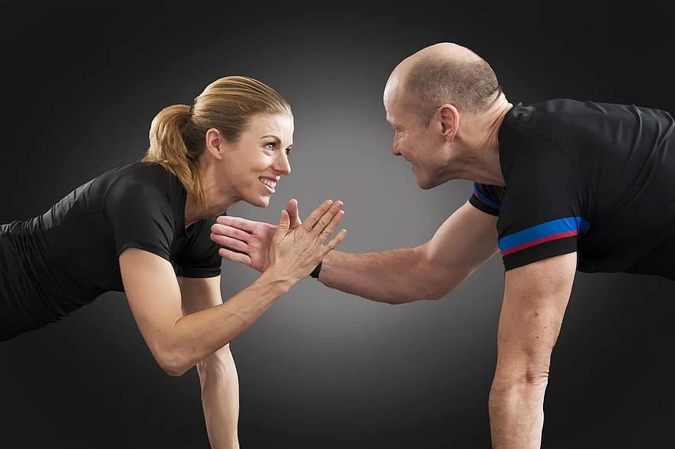
Fitness Fridays!
This is an opportunity for your student to make up points loss due to not being dressed for PE or for an absence!
10 points maximum earned
3 x non-suits or 1 x absence
2:45-3:15 PM on Fridays after school (every other Friday unless noted otherwise – message will be sent out)
Must be dressed in their PE uniform.
Must stay for the entire 30 minutes and be on time.
Must be on time & ready at 2:45 or 10 minutes after the school day.
1, 2, or 3 of the PE teachers will conduct the students through a 30-minute workout

Slide 12
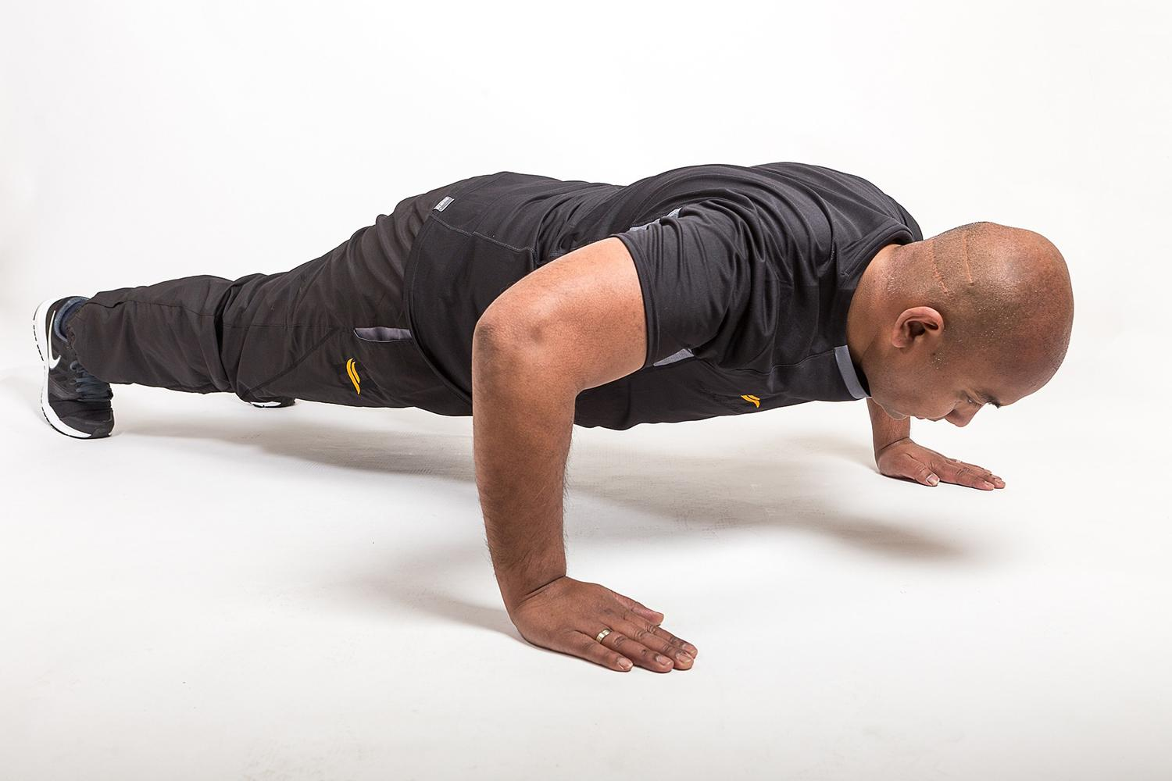
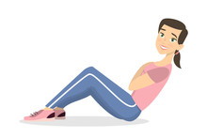
Make-up Monday!
This is an opportunity for your student to make up missed fitness tests due to being absent, injured, or ill.
*Students who did not have appropriate shoes, had an unexcused absence, or chose to not participate are not allowed to make-up tests.
Designated Mondays after school
announced in class &
written on the whiteboard/calendar
In the gym, immediately after school.
1, 2, or 3 PE teachers will conduct the make-up test(s).

Slide 13
Injury Excuse
If a student is injured and unable to participate in Physical Education, he/she must bring a note from his/her parent (good for up to 3 days if specified) or doctor to be excused.
It is the STUDENT’s responsibility to get the assignment at the beginning of class.
Doctor excuse notes will be honored as long as stated. In this case, the student will receive a contract and are to complete a written assignment daily to earn their daily points during the time of injury.

Slide 14
What games or sports will we play?
We focus a lot on teamwork & cooperation.
We will learn SKILLS through non-traditional games & activities.
Generally speaking, traditional sports will be modified to make PE more fun, and successful for ALL of the students!

Slide 15
Grading
75% | Daily Points (10 points per day) 5 – Warm-up and/or Cool-down Activities 5 –Participation/Effort in class drills or the main activity *Students not wearing proper shoes or clothing may not be allowed to participate.
25% | Classwork & Other Assignments Including but not limited to: Written Assignments Quizzes Google Classroom Passing Scores based on FitnessGram Standards (Standards are based on gender and age as of March 15, 2023, when we begin the state mandated fitness testing). Improvement on Fitness Tests Individual Fitness Sheets (IFS)

Slide 16
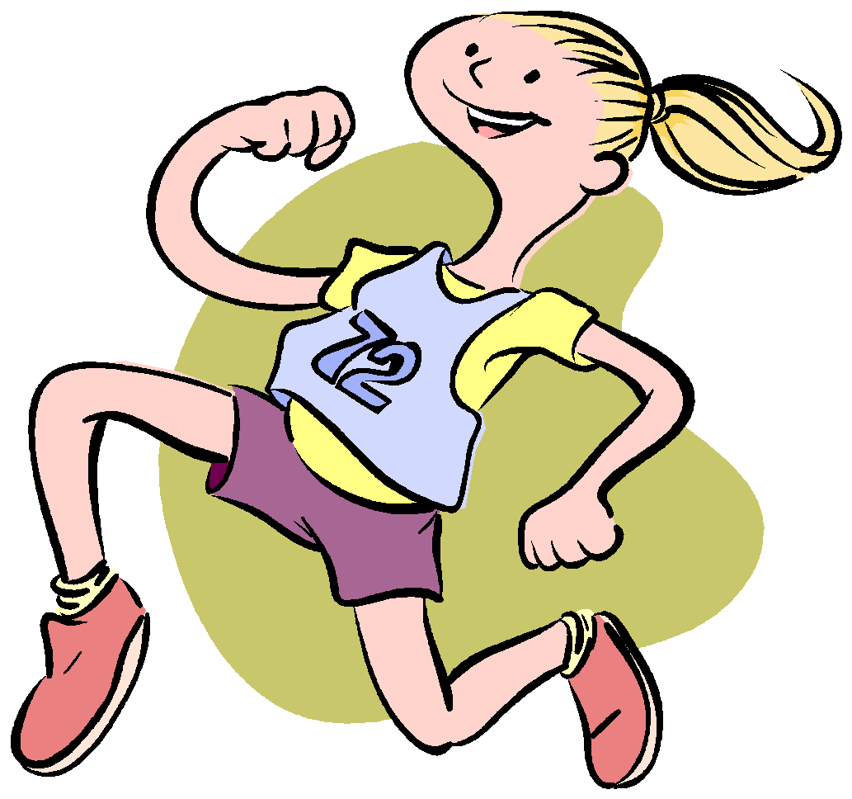
Physical Fitness Testing
Mandated State Physical Fitness Testing in March
Mile Run – used to calculate VO2 Max
PACER (Progressive Aerobic Cardiovascular Endurance Run) – used to calculate VO2 Max
Push-ups – Muscular Strength & Endurance
Curl-ups – Muscular Strength & Endurance
Trunk Lift – Flexibility & Lower Back Strength
Shoulder Stretch – Flexibility
Back-Saver Sit & Reach - Flexibility
Height & Weight - Body Mass Index*

Slide 17
Percentage of Students who Passed Physical Fitness Testing
COMPONENT TESTED | TEST | 2014-2015 | 2015-2016 | 2016-2017 | 2017-2018 | 2018-2019
Body Composition | Height Weight | 62 % | 64 % | 54 % | 52 % | 54.2 %
Aerobic Capacity – VO2 Max | Mile Run & PACER along with Ht. & Wt. | 80 % | 85 % | 84 % | 77 % | 66.3 %
Upper Body Strength & Endurance | Push-ups | 74 % | 53 % | 65 % | 76 % | 88.4 %
Abdominal Strength & Endurance | Curl-ups | 89 % | 81 % | 78 % | 91 % | 88.9 %
Flexibility | Shoulder Stretch & Back-Saver Sit & Reach Tests | 98 % | 90 % | 97 % | 73 % | 65.8 %
*Note: this data is pre-pandemic.

Slide 18
PE & HMS PTO Sponsored Events
Zombie Run Fundraiser during PE classes
Family Volleyball Night
Color Run during PE classes
Family Badminton & Pickleball Night
*All funds raised help to support the
entire school, not just PE.
JOIN THE HMS PTO TO HELP
SUPPORT OUR STUDENTS!

