Slide 1
Ms. Colliver
Math 6
Email:
CCOLLIVER@
WCCUSD.NET

Slide 2
Teacher Contact:
Email:
CCOLLIVER@WCCUSD.NET
Best way to contact
Response will be during school hours
Please allow 2 full school days for a response

Slide 3
Typical Class Day
Warm-up
2-4 Questions
Review of 5th grade standards
Review current topics
Special weekly warm-up sheet
Unit Work - Desmos Platform
Most work is done with a partner or small group
Discussion and discovery based (not the traditional teaching and learning methods that many of us grew up with).
Complete assignments in workbook
SHOW THE WORK!
Homework
Homework
Show written work on workbook pages
Input into Desmos platform
At the end of the Homework
Check work, make corrections

Slide 4
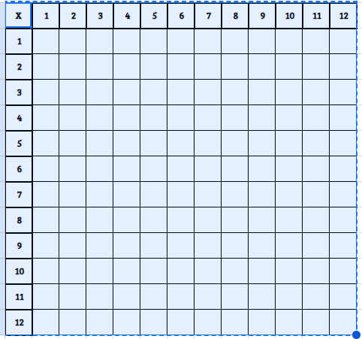
Wednesdays -
Timed Multiplication Tables
How well do we know our multiplication facts?
Quarterly rewards.

Slide 5
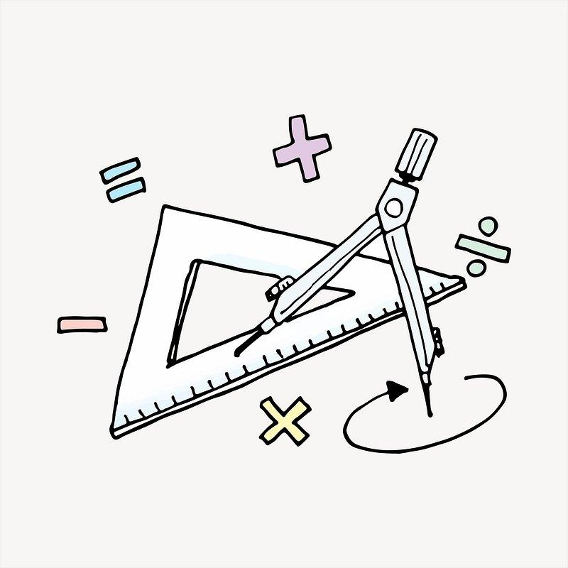
Math 6 Units
Area & Surface Area | 5. Decimal Arithmetic
2. Introducing Ratios | 6. Expressions & Equations
3. Unit Rates & Percentages | 7. Positive & Negative Numbers
4. Dividing Fractions | 8. Describing Data

Slide 6
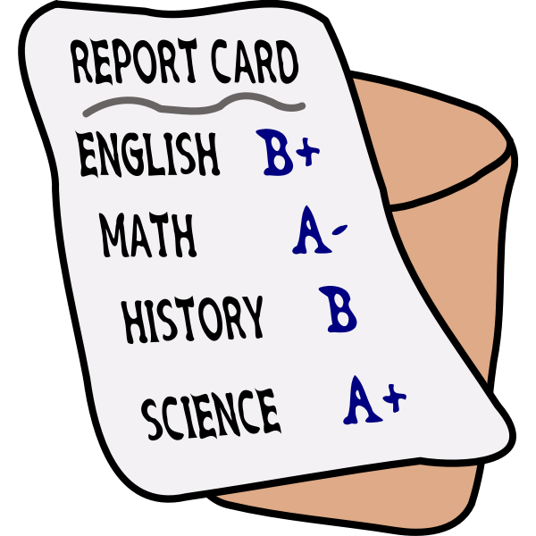
GRADE COMPOSITION
50 % Learning Assessments (tests) & Learning Checks (quizzes)
50 % Including, but not limited to: Educational Activities (classwork), Extra Practice (homework), and Projects
*Based on point accumulation per quarter.

Slide 7
LEARNING CHECK(QUIZ)
RETAKES
Allowed 1 retake per quiz.
Should be completed within 1 week of the original quiz being handed back to the student.
The student must make arrangements to:
Meet with the teacher to review materials.
Make an appointment with the teacher to retake the quiz.

Slide 8
Learning Assessments/Tests
Learning Assessments/Tests will be graded on an accumulation of points.
** END OF UNITS **
o Students may make test corrections to earn up to ½ of the points missed (for example if a student missed 10 points, their test corrections may earn up to 5 points back on their test grade).
o Students will have 1 week from the return of the test to turn in their test corrections.
o Test corrections must be done on a separate sheet of paper and must follow the designated format, which includes showing their work and explaining what they did incorrectly on the original test (format posted in Google Classroom).

Slide 9
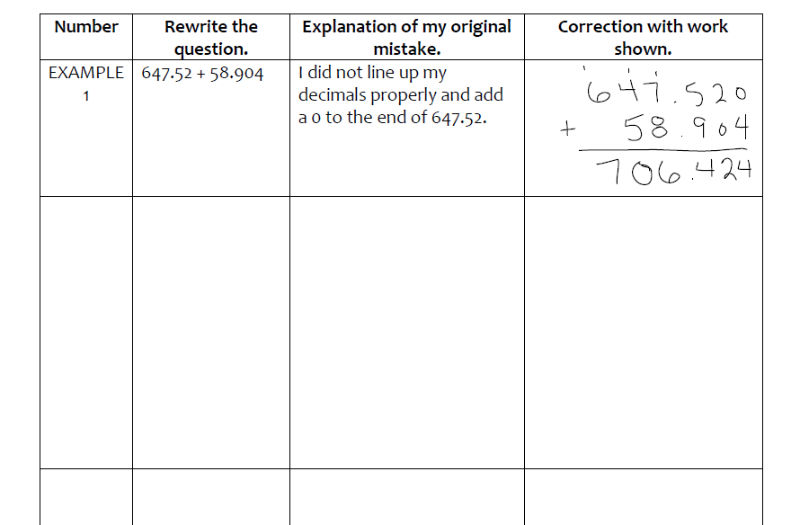
TEST CORRECTION FORM
This form may be found in Google Classroom.
Paper copies will be given to students during class.

Slide 10
RULES & EXPECTATIONS
Follow the Titan Values:
Titans are KIND!
Titans are RESPONSIBLE!
Titans are SAFE!
Be Respectful!
Be Prepared - have materials, ready to learn, and ready to participate!
Cell phones are silenced and put away.

Slide 11
Excused Absence
All ABSENCES should be reported to the attendance clerk - Ms. Ashley Pera
Email: ashley.pera@wccusd.net
Student should check Google Classroom and Desmos for any assigned work.
Student should check with the teacher upon return if they missed any other assignments.
Check “Absent?” Box

